Slide 1



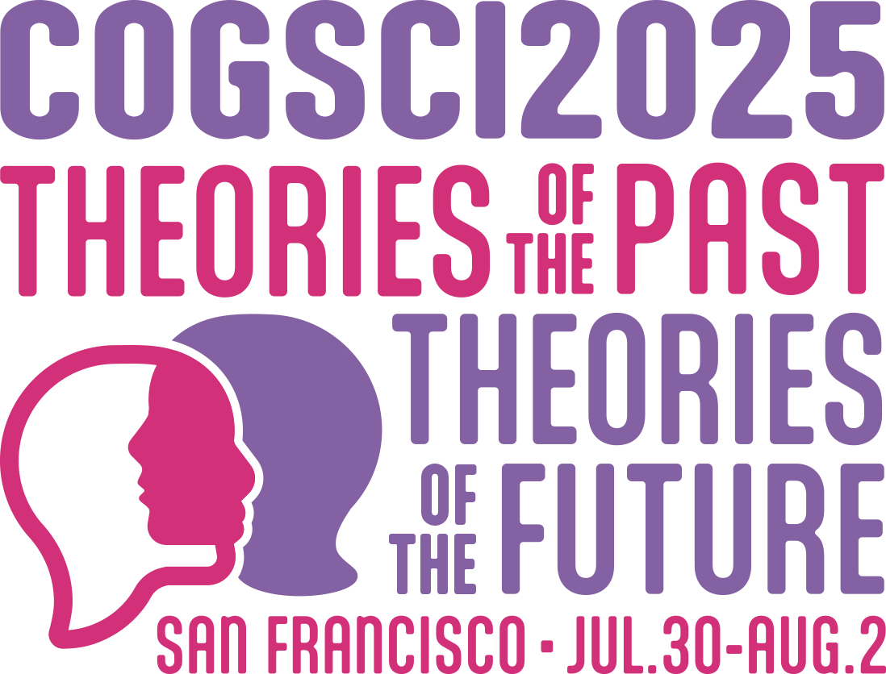

Probing and Inducing Combinational Creativity in Vision-Language Models
¹PEKING
UNIVERSITY
²BIGAI
Yongqian Peng^{*,1}, Yuxi Ma^{*,1}, Mengmeng Wang², Yuxuan Wang²,
Yizhou Wang¹, Chi Zhang², Yixin Zhu^{1,} , Zilong Zheng^{2,}
*equal contribution corresponding authors

Slide 2
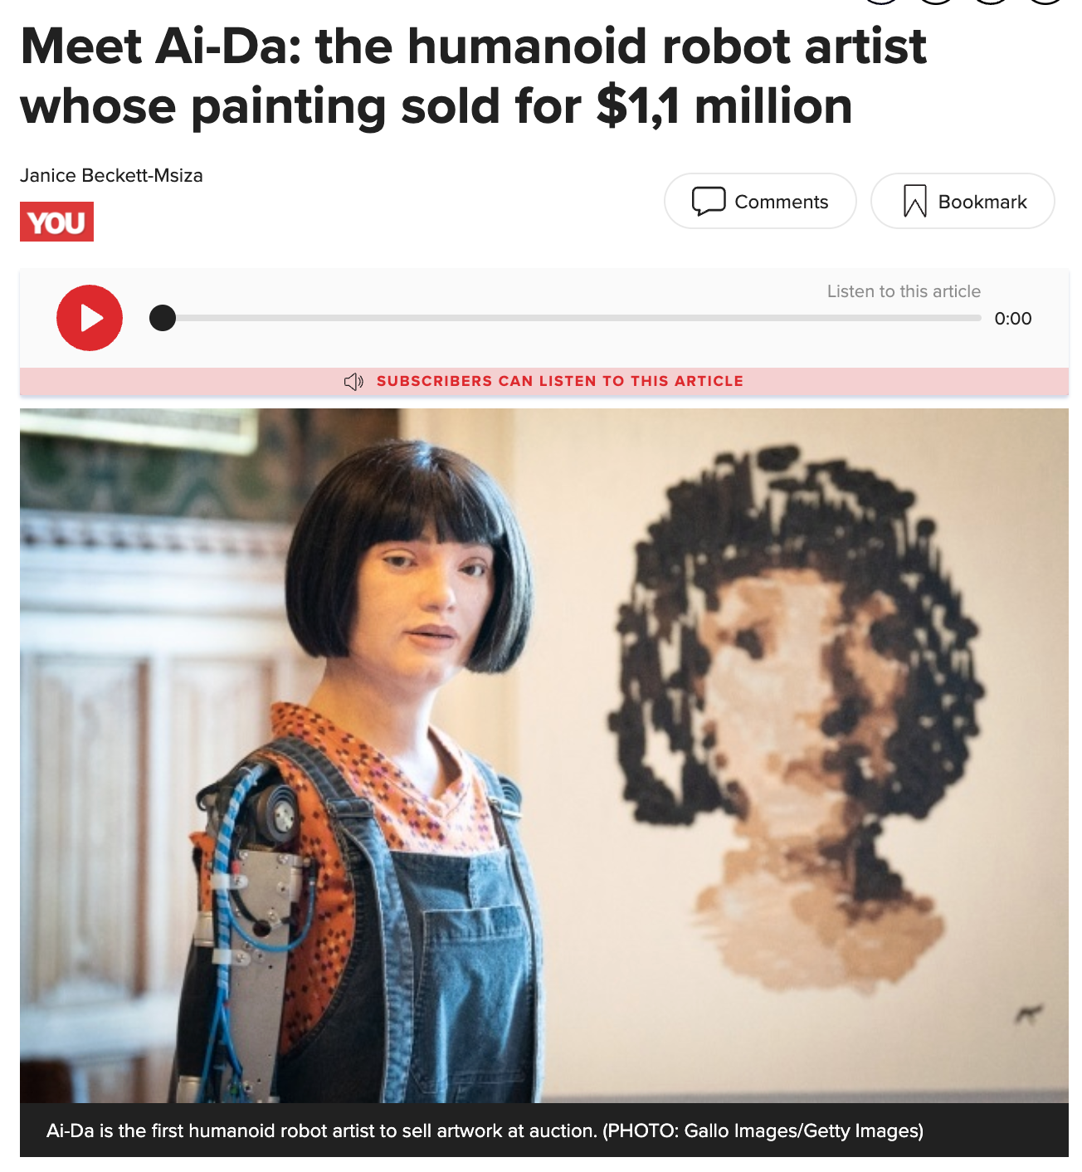
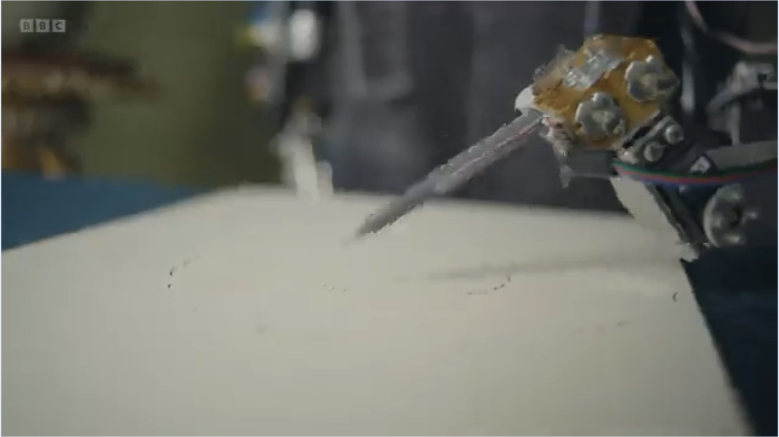
Background
https://www.bbc.com/news/videos/cn4vwq0v9v5o
https://www.news24.com/you/news/international/meet-ai-da-the-humanoid-robot-artist-whose-painting-sold-for-11-million-20241112
Do these creative products generated by AI emerge from genuine creative processes or sophisticated pattern matching?

Slide 3
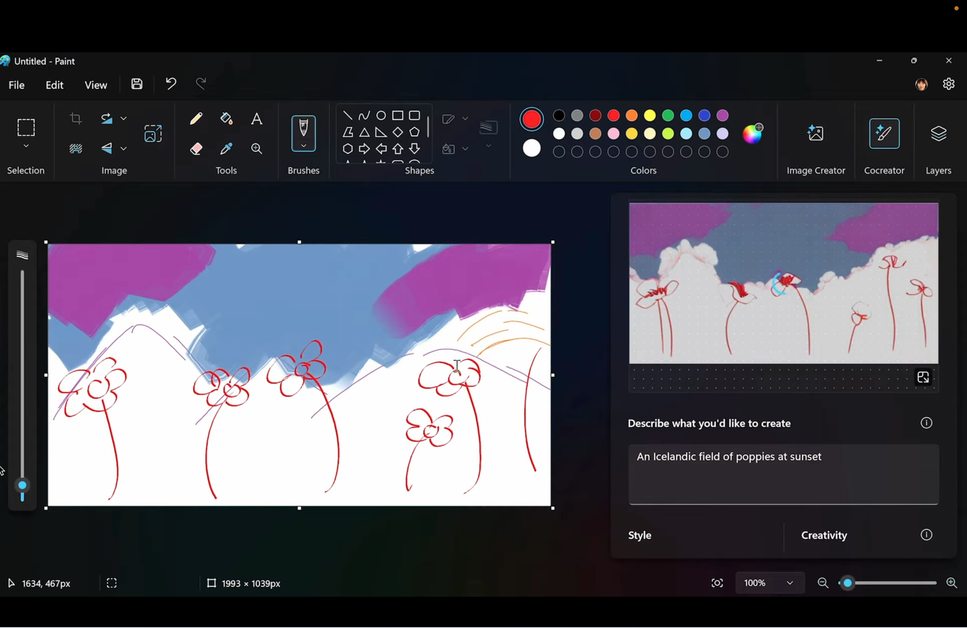
Why Study Machine Creativity?
“Creativity is the ability to produce work that is both novel and useful.”
Understanding Human Creativity Better
Enhancing Human Creativity
https://www.youtube.com/watch?v=VBRYaeK_cT0

Slide 4
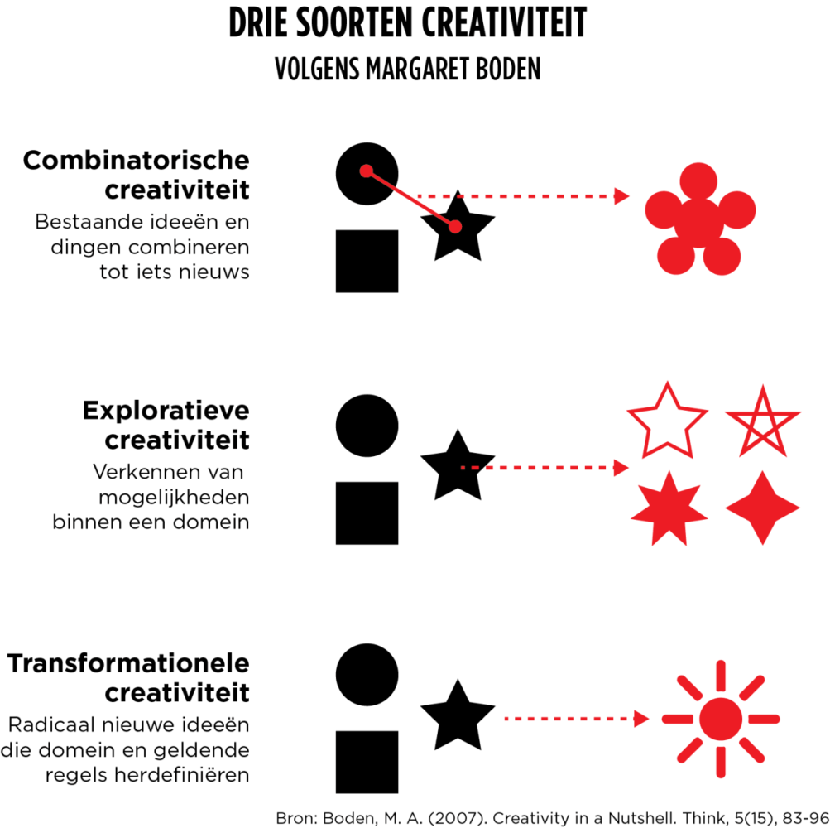
Combinational Creativity in AI
Combinational Creativity
Combining existing ideas and things into something new
Explorative Creativity
Exploring possibilities within a domain
Transformational Creativity
Radically new ideas that redefine the domain and existing rules
Boden, M. A. (2007). Creativity in a nutshell. Think, 5 (15), 83–96.

Slide 5
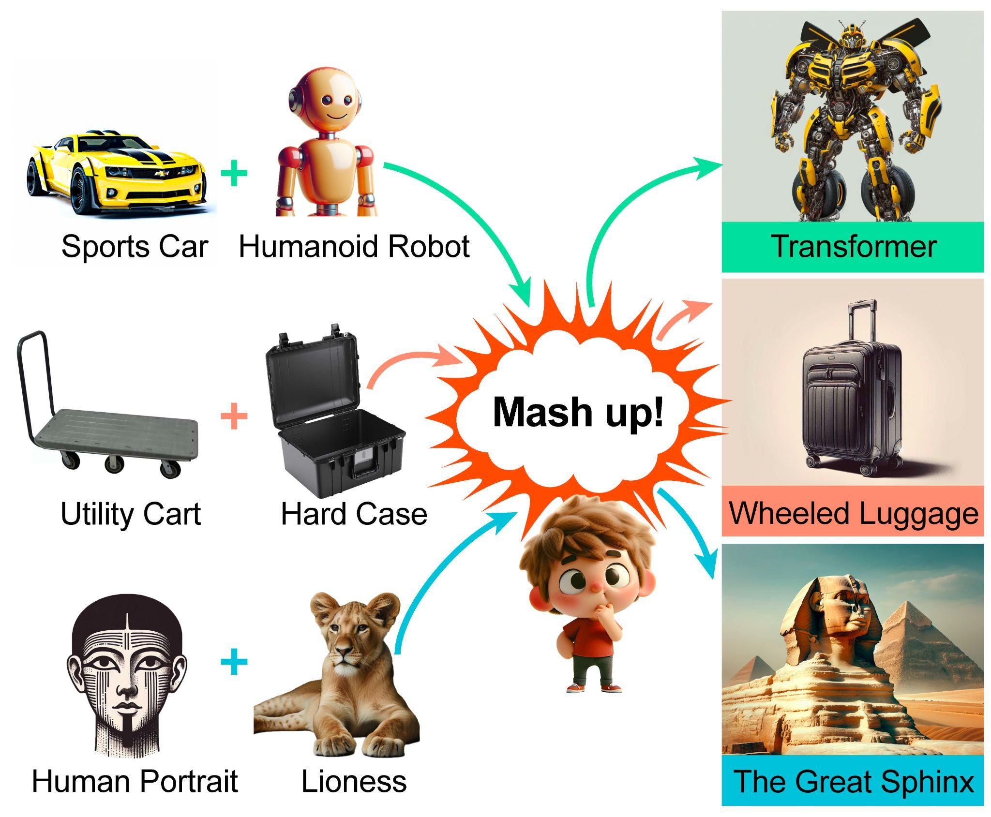
Combinational Creativity in AI
Boden, M. A. (2007). Creativity in a nutshell. Think, 5 (15), 83–96.
Combinational Creativity
Combining existing ideas and things into something new
Well-defined
Easy to implement
Empirically dominant

Slide 6
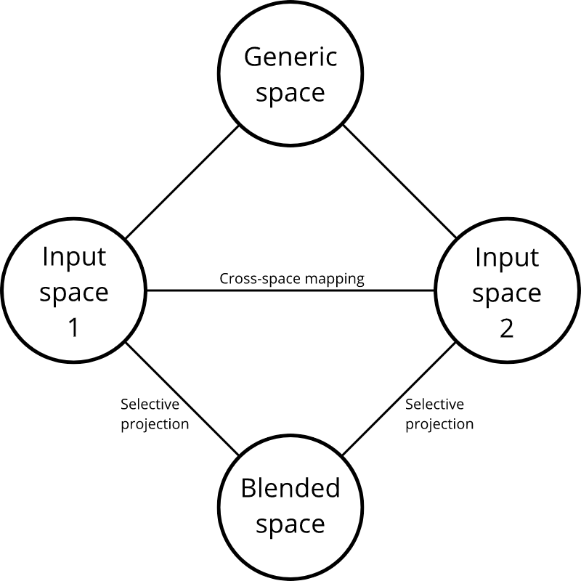
Conceptual Blending Theory
How It Works: The Four‑Space Model
Two Input Spaces
  Each contains a separate scenario or concept.
Generic Space
  Captures what is common across both inputs—shared structure or schema.
Blend Space
  Selectively projects parts from the inputs into a new space, yielding emergent meaning.
https://commons.wikimedia.org/wiki/File:Conceptual_blending_-_the_network_model.png

Slide 7



Conceptual Blending Theory – An Example
Generic Space:
Shared abstract structure:
  An agent that enters a system
  Spreads or replicates within that system
  Potentially causes damage or disruption
Input Space 1: Computer Program
Blended Space: Computer Virus
Input Space 2: Biological Virus

Slide 8
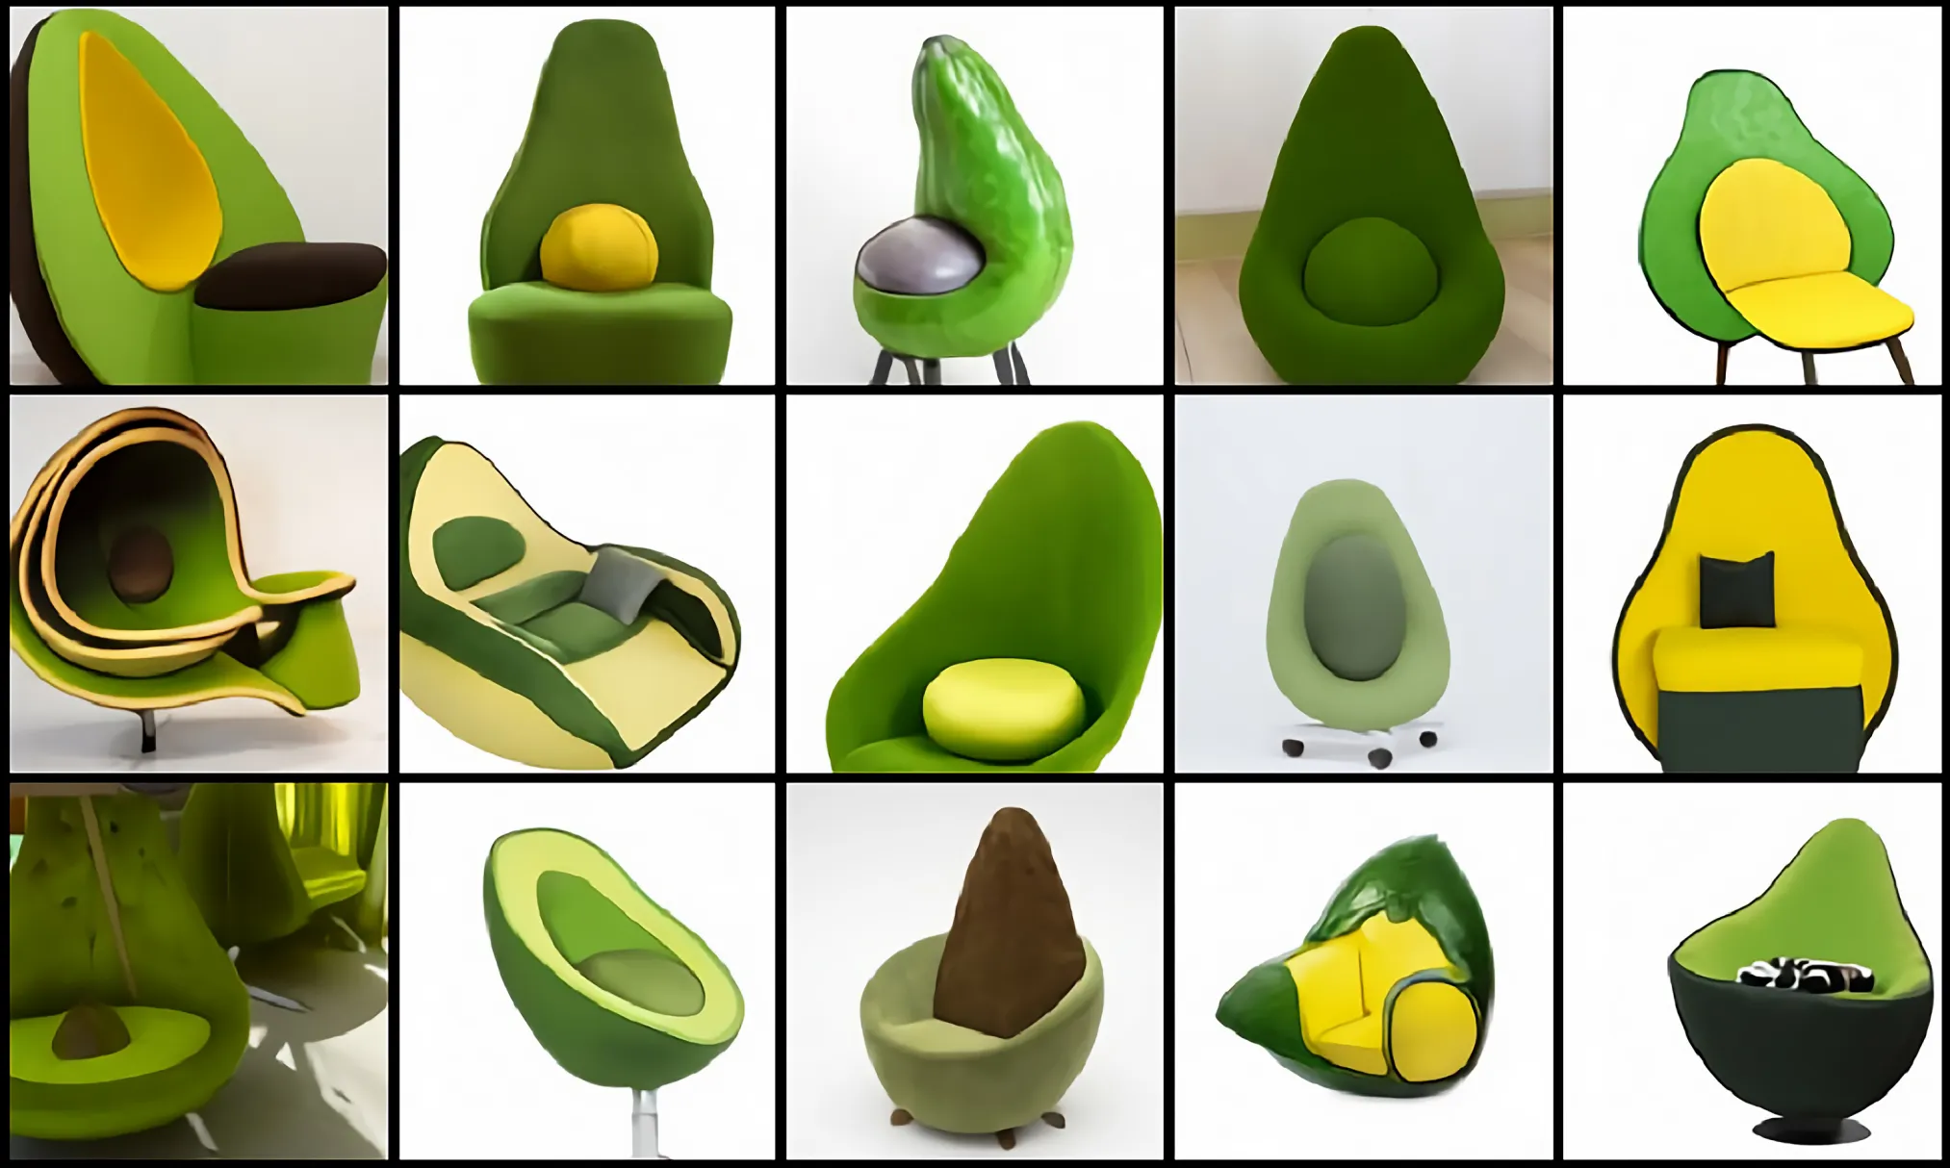
Research Questions
Peng, Y., Ma, Y., Wang, M., Wang, Y., Wang, Y., Zhang, C., ... & Zheng, Z. (2025). Probing and inducing combinational creativity in vision-language models. arXiv preprint arXiv:2504.13120.
https://openai.com/index/dall-e/
To what extent can VLMs comprehend combinational creativity?
Can the explicit integration of the combination process enhance models' ability to generate more creative products?

Slide 9
Overview
We built a three-level framework of combinational creativity and a novel dataset containing mashup images for comprehensive analysis of how VLMs understand combinational creativity.
We study whether explicitly incorporating this three-level framework into the generation process can enhance text-to-image models’ ability to generate creative mashup images.

Slide 10
Three Levels of Combinational Creativity
Identification-level — Input Space
Identify the objects used in the combination from the final product, answering: What objects are used for a combination?
Shared abstract structure:
  An agent that enters a system
  Spreads or replicates within that system
  Potentially causes damage or disruption
Explanation-level — Generic Space
Explain the principles behind the combination, delving into relationships between objects, and answering: How does the combination work?
Implication-level — Blended Space
Examine the underlying meaning behind the combinational creativity product, answering: What is the meaning of the combination?

Slide 11
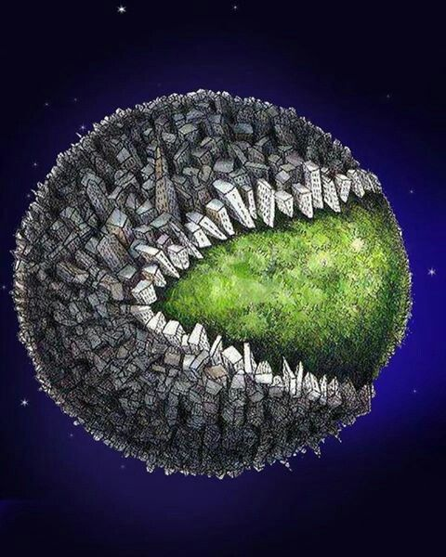
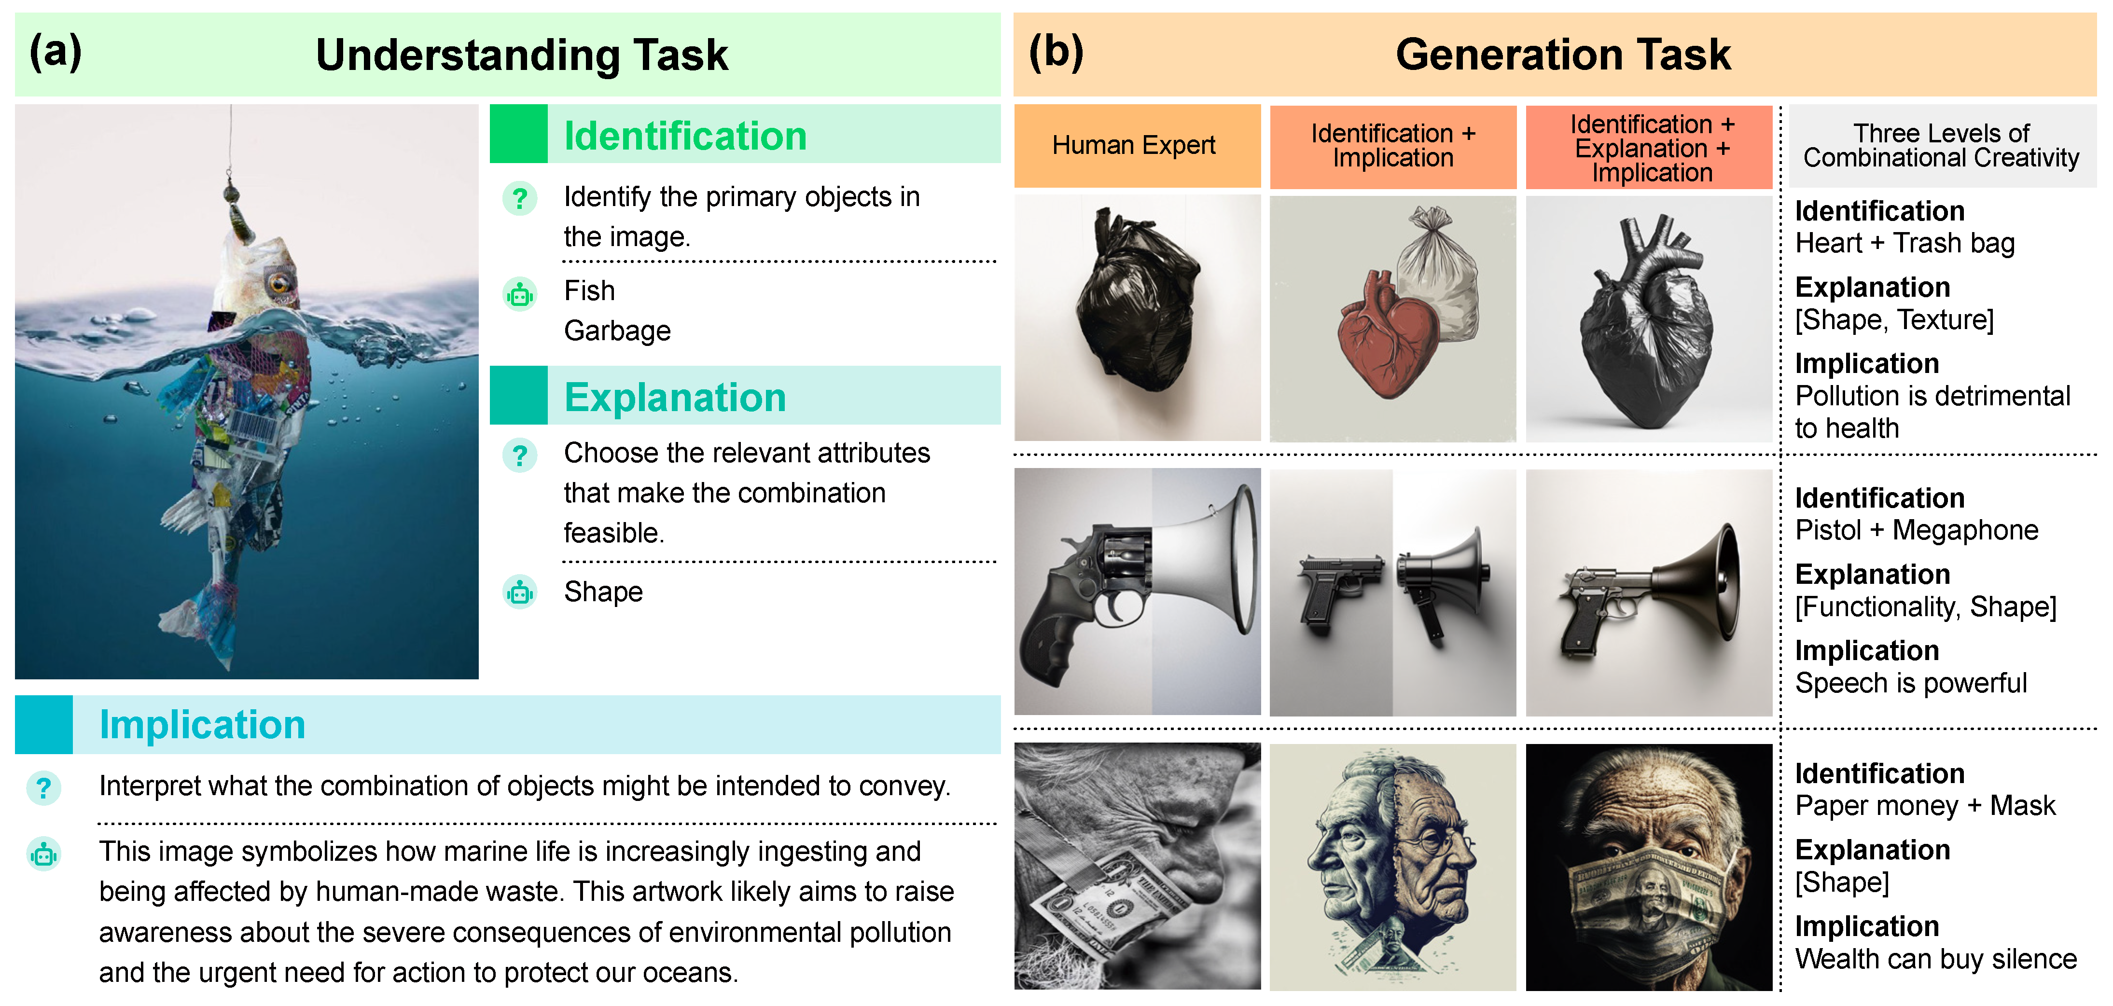



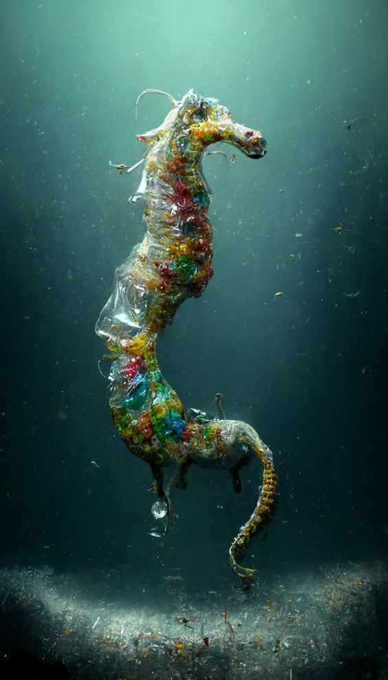
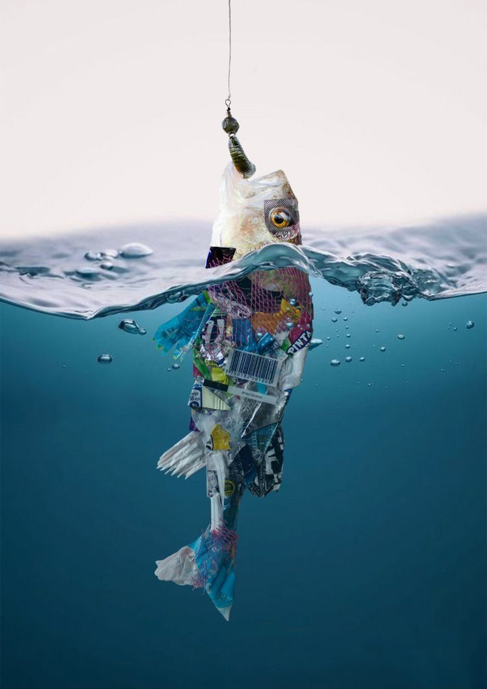

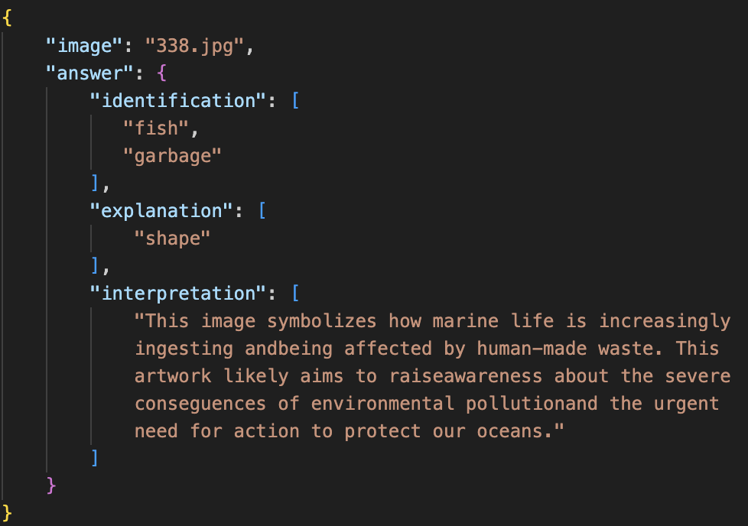
CreativeMashup Dataset
666 mashup images
Annotated data

Slide 12

Understanding Task
Identification
Ground Truth
Response
Mapping
Explanation
Ground Truth
Selected Option(s)
['shape', 'color', 'functionality’, …]
Implication
Implication from Model I
Implication from Model II
Pair-wise comparison

Slide 13
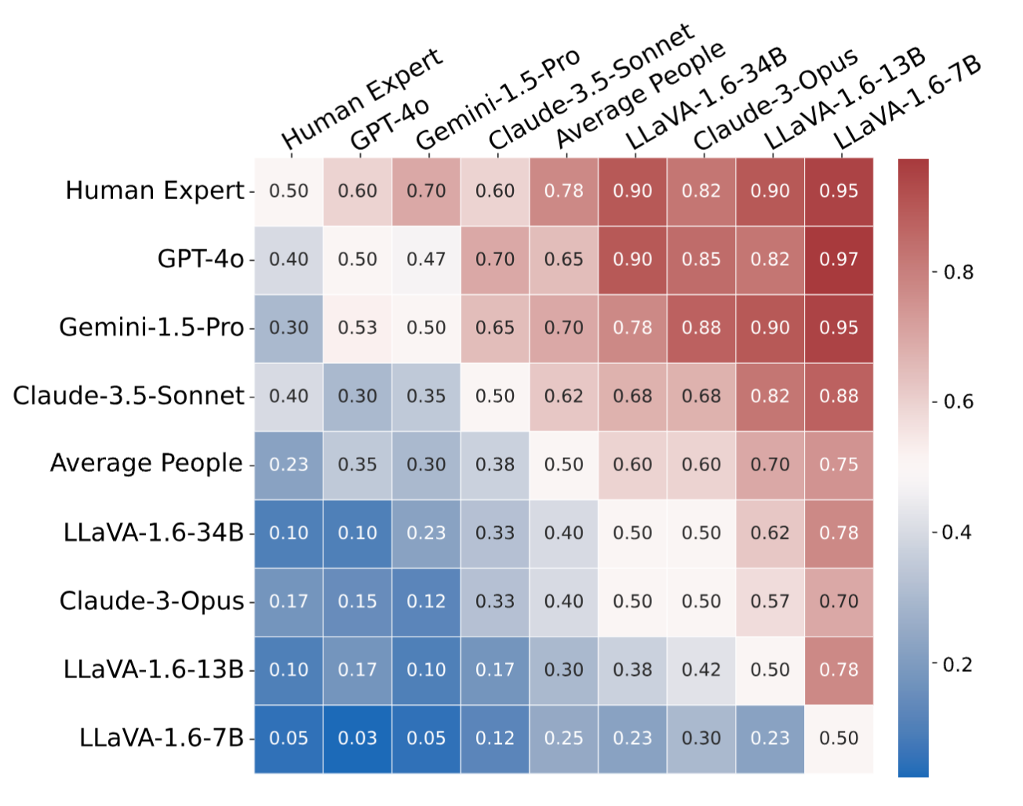
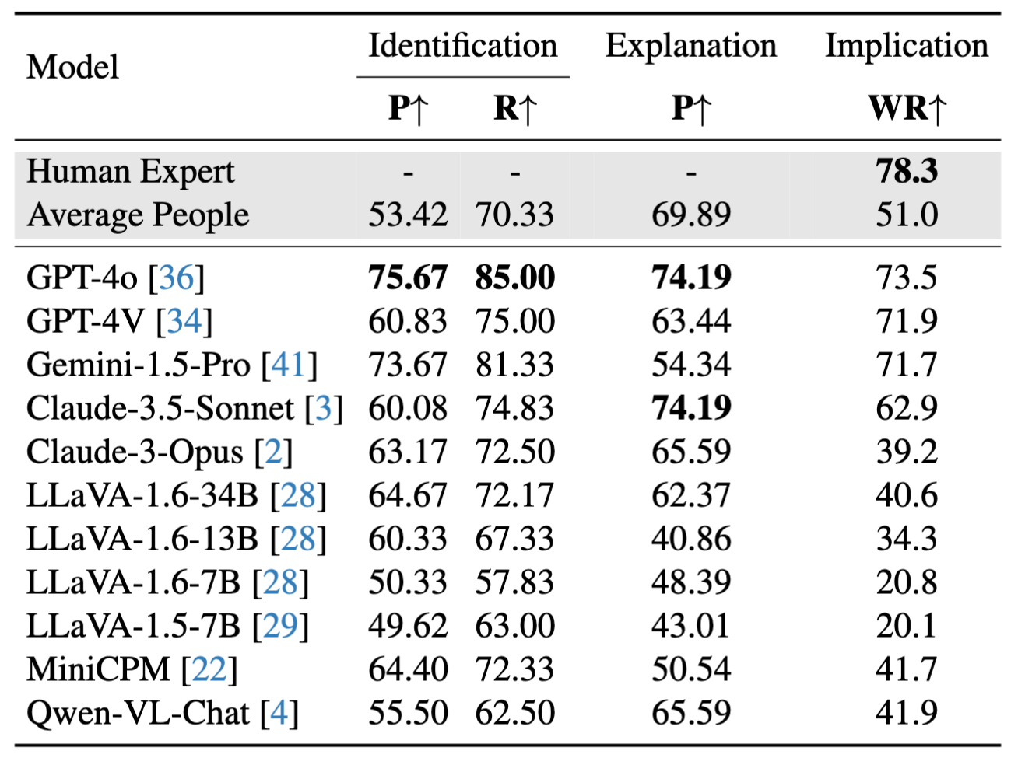
Do VLMs Understand Combinational Creativity?
State-of-the-art models have achieved human-level understanding in combinational creativity.
Human experts still surpass models in the realm of combinational creativity.

Slide 14
Generation Task
RQ: Can the explicit integration of the combination process enhance models' ability to generate more creative products?
Human Expert
Identification + Implication
(Chain of Thought)
Identification + Explanation + Implication (Conceptual Blending)

Slide 15





Generation Task
Identification + Implication
(Chain of Thought)
heart
trash bag
GPT-4o
(CoT)
pollution is detrimental to health
Identification + Explanation + Implication (Conceptual Blending)
heart
trash bag
text-to-image models
texture, shape
GPT-4o
(IEI thinking process )
pollution is detrimental to health

Slide 16
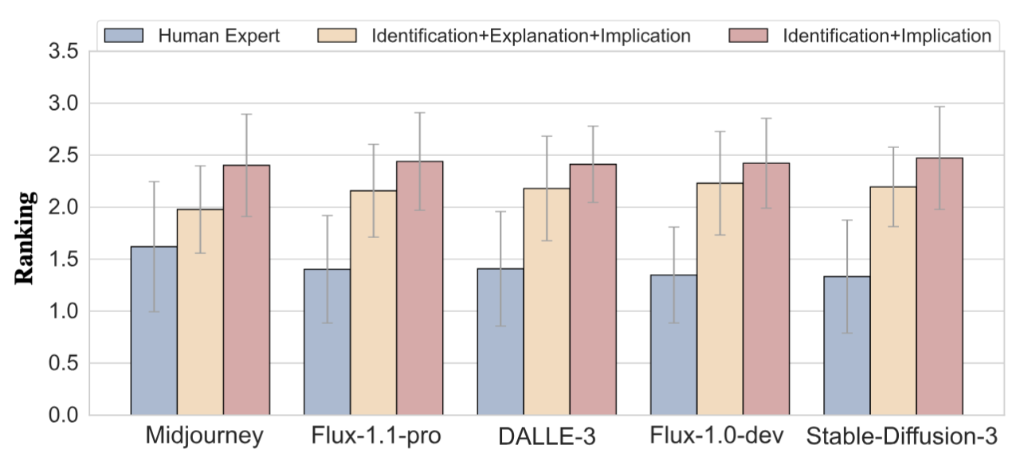
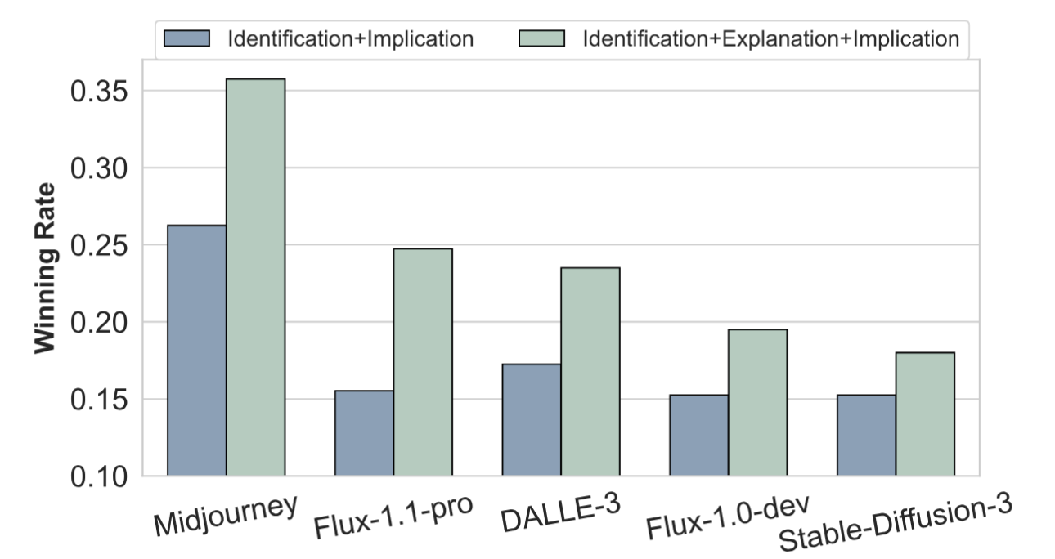
Results of Generation Experiment
The explanation level of combinational creativity can be leveraged to enhance creativity
II (M = 487.95)
IEI (M = 514.53)
T-test stat: 0.84 p-value: 0.40
without making the prompts
significantly longer.
Text-to-image models are currently the bottleneck in generating visual combinational creativity.
Text: 90% (36/40)
Text-to-image: 27.8% (10/36)

Slide 17
Take-away Message
State-of-the-art models have achieved human-level understanding in combinational creativity, but still lag behind human experts.
The explanation level of combinational creativity can be leveraged to enhance creativity without making the prompts significantly longer.
Text-to-image models are currently the bottleneck in generating visual combinational creativity.

Slide 18
References
Holyoak, K. J., & Thagard, P. (1996). Mental leaps: Analogy in creative thought. MIT press.
Boden, M. A. (1998). Creativity and artificial intelligence. Artificial intelligence, 103(1-2), 347-356.
Fauconnier, G., & Turner, M. (2003). Conceptual blending, form and meaning. Recherches en communication, 19, 57-86.
Boden, M. (2009). Creativity: How does it work. The idea of creativity, 28, 237-50.
Kaufman, J. C., & Sternberg, R. J. (Eds.). (2010). The Cambridge handbook of creativity. Cambridge University Press.
Park, S., Nie, B. X., & Zhu, S. C. (2017). Attribute and-or grammar for joint parsing of human pose, parts and attributes. IEEE transactions on pattern analysis and machine intelligence, 40(7), 1555-1569.
Richardson, E., Goldberg, K., Alaluf, Y., & Cohen-Or, D. (2024). Conceptlab: Creative concept generation using vlm-guided diffusion prior constraints. ACM Transactions on Graphics, 43(3), 1-14.
Wei, J., Wang, X., Schuurmans, D., Bosma, M., Xia, F., Chi, E., ... & Zhou, D. (2022). Chain-of-thought prompting elicits reasoning in large language models. Advances in neural information processing systems, 35, 24824-24837.

Slide 19

Thanks for listening!
Project website:
https://ppyyqq.github.io/aicc/
Personal homepage:
https://ppyyqq.github.io/
Drop me an email :)
yqpeng@stu.pku.edu.cn

